Slide 1

Metadata
Kirstyn Brunker
RAGE workshop, SCENE, University of Glasgow
12-16 February 2024

Slide 2
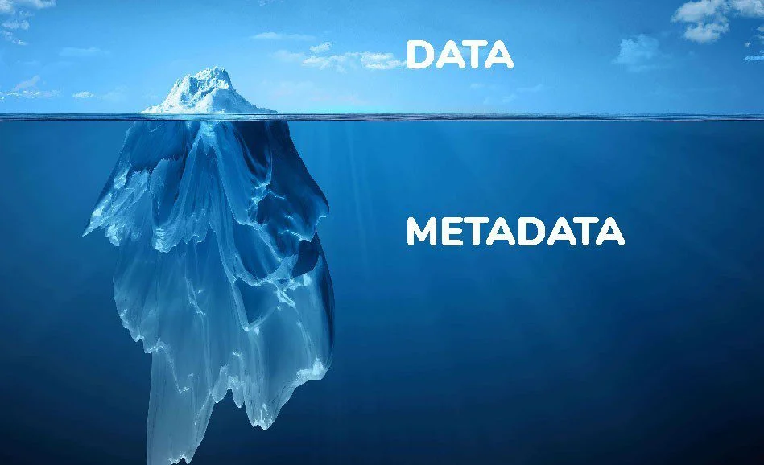
'Data about data’
Description and context of the data.
It helps to organize, find and understand data.

Slide 3
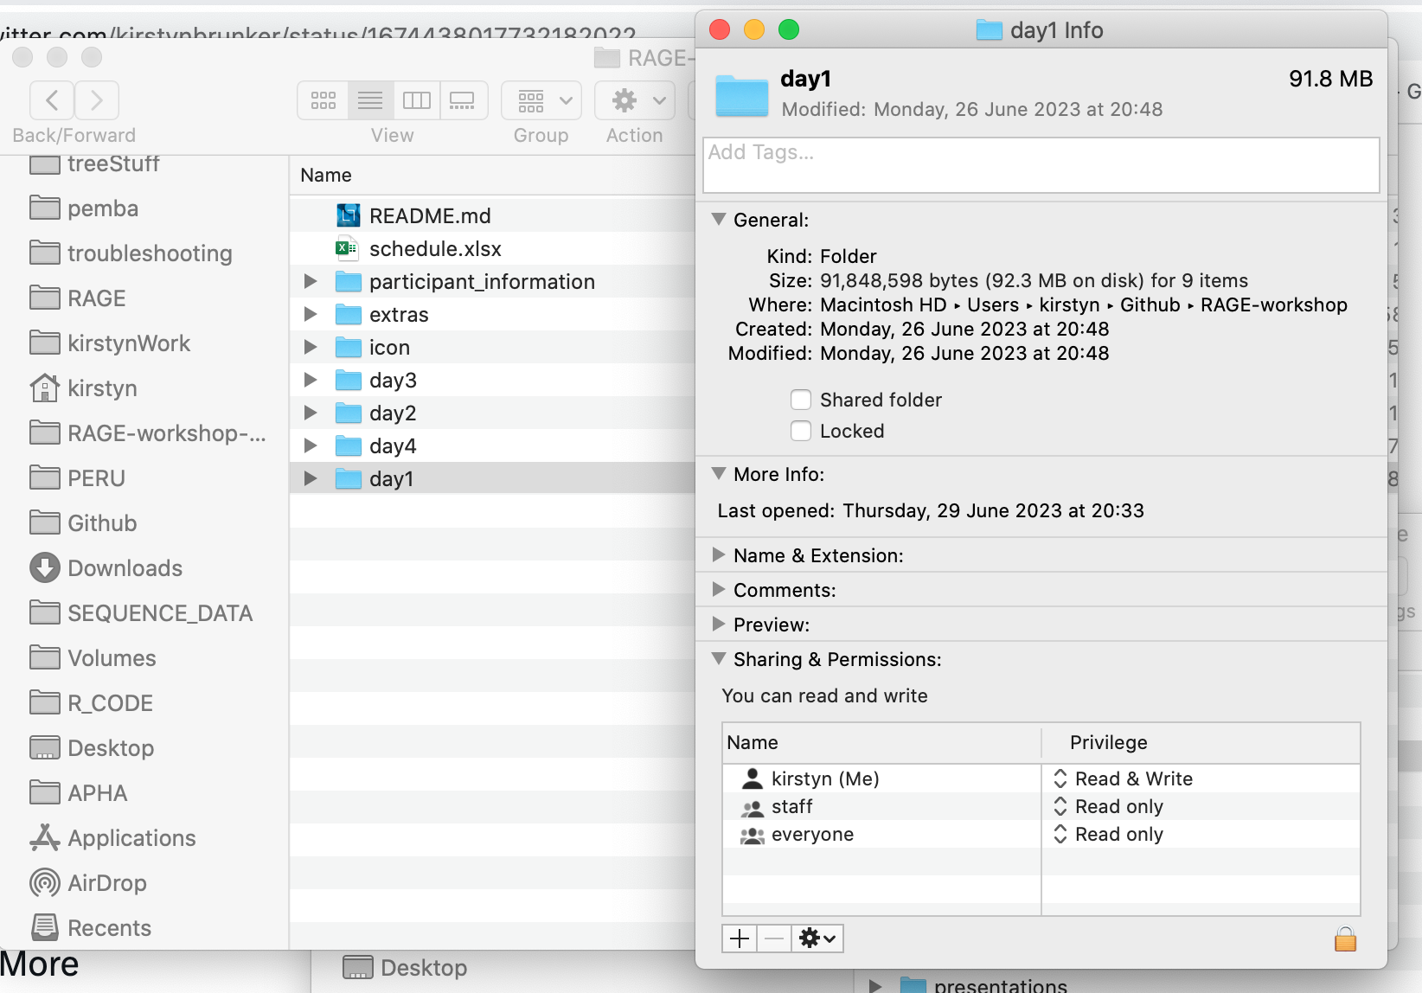
Data
Metadata

Slide 4
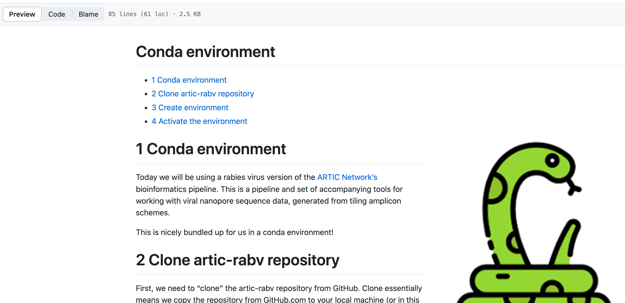
Metadata
Data
Metadata

Slide 5
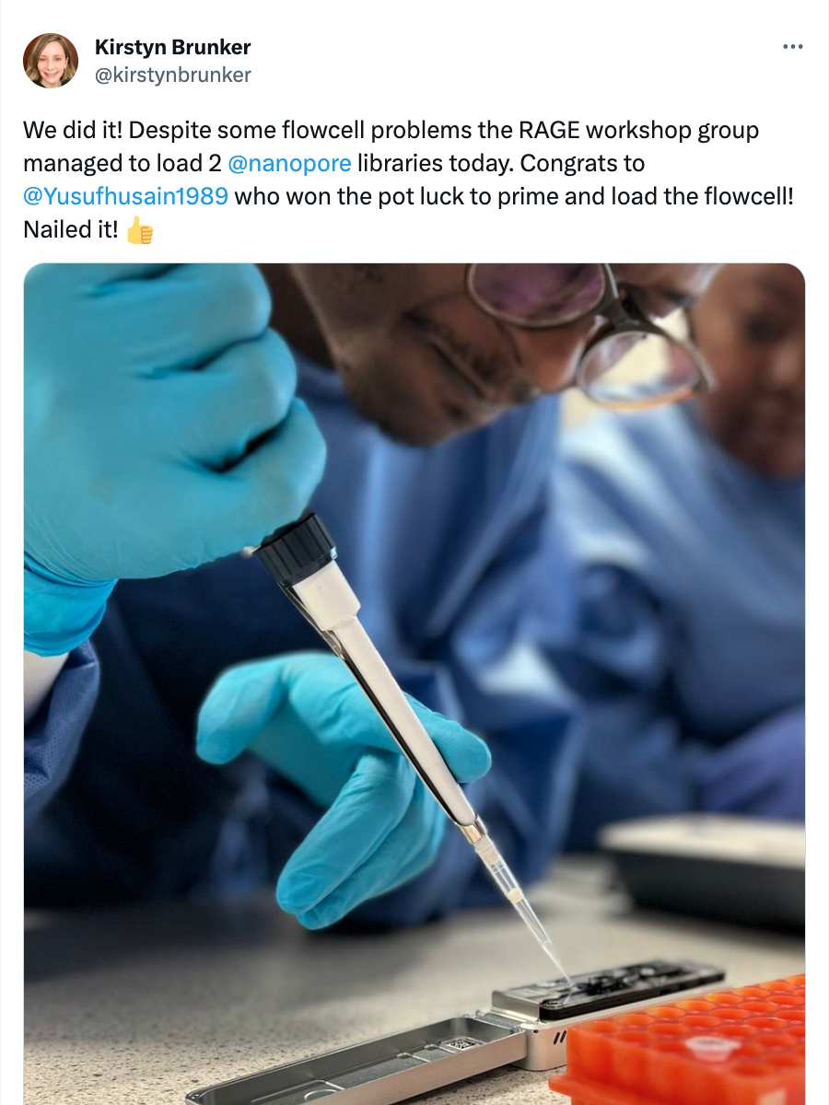
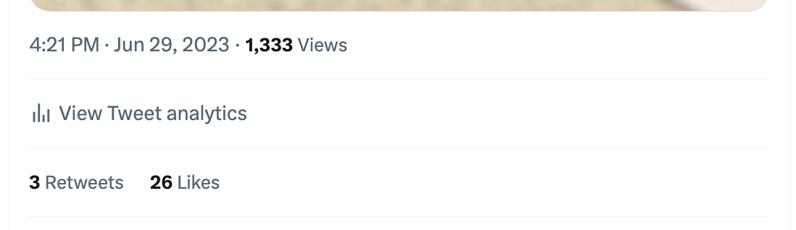
Data
Metadata

Slide 6
Why is it important?
Valuable context and information about the samples used in a study to draw meaningful conclusions and share data effectively
Experimental Design and Context
Data Interpretation and Analysis
Quality Control and Data Validation
Reproducibility and Data Sharing
Ethical Considerations and Compliance
Notes:
Sample metadata provides information about the origin, characteristics, and conditions of the samples used in a study.
It helps researchers design experiments, interpret data, and control for confounding factors.
Sample metadata ensures data quality, reproducibility, and compliance with ethical standards.
Proper documentation of sample metadata facilitates data sharing and enables others to evaluate and utilize the data effectively.

Slide 7
Best practices
It is absolutely vital that you have good data recording, organisation and validation practices for any metadata
Case metadata
Sample metadata
Sequence metadata

Slide 8
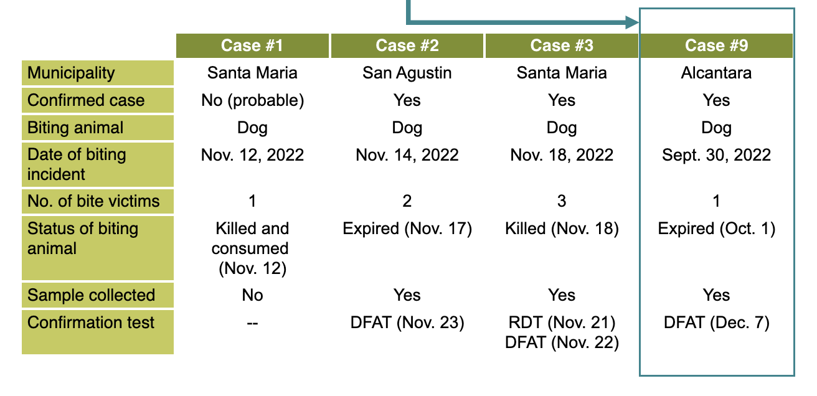
Case metadata
Index Case

Slide 9
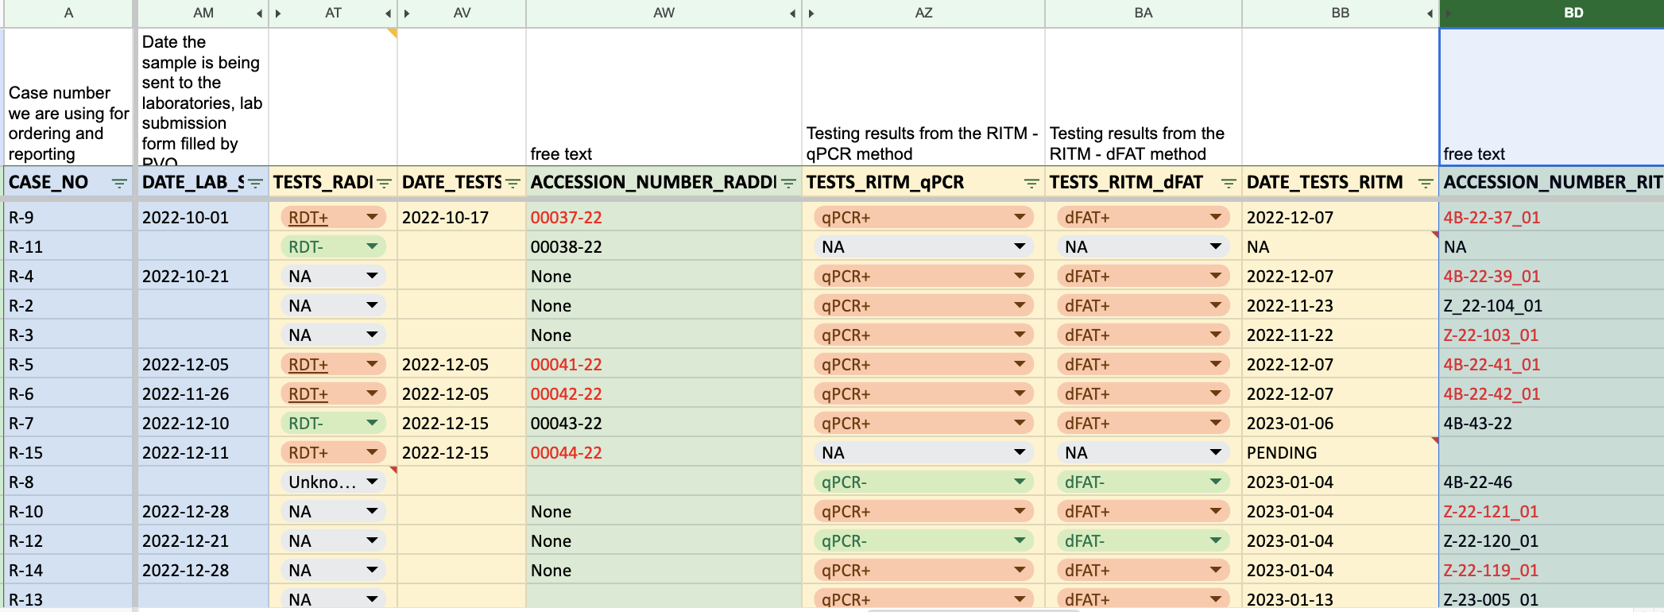
Sample metadata

Slide 10
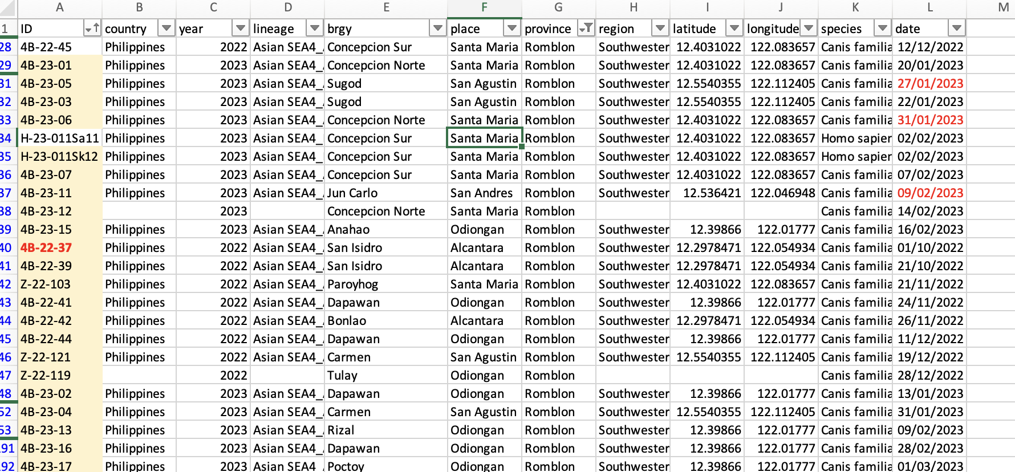
Sample metadata

Slide 11
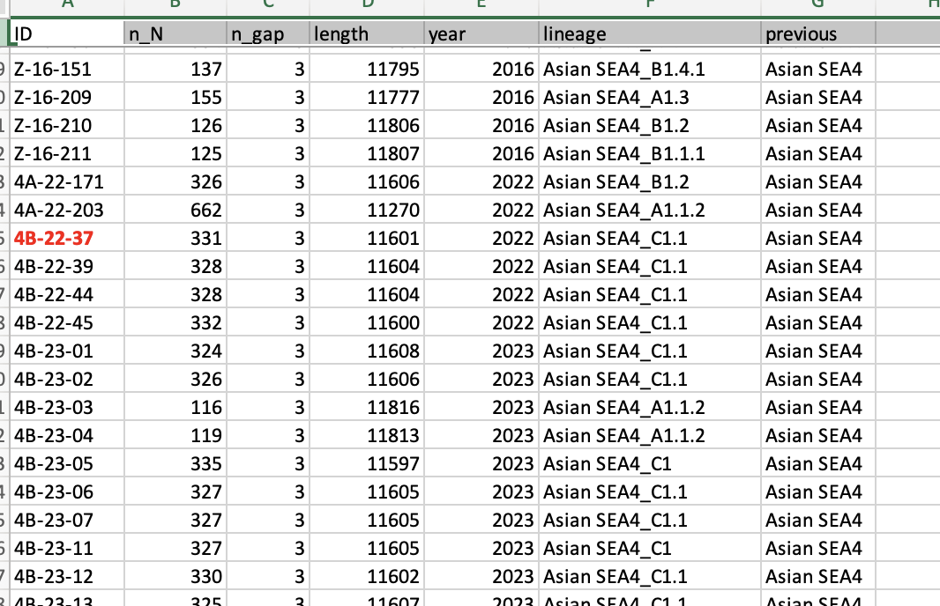
Sequence metadata

Slide 12


Consider sharing metadata with collaborators or depositing it in public repositories.

Slide 13
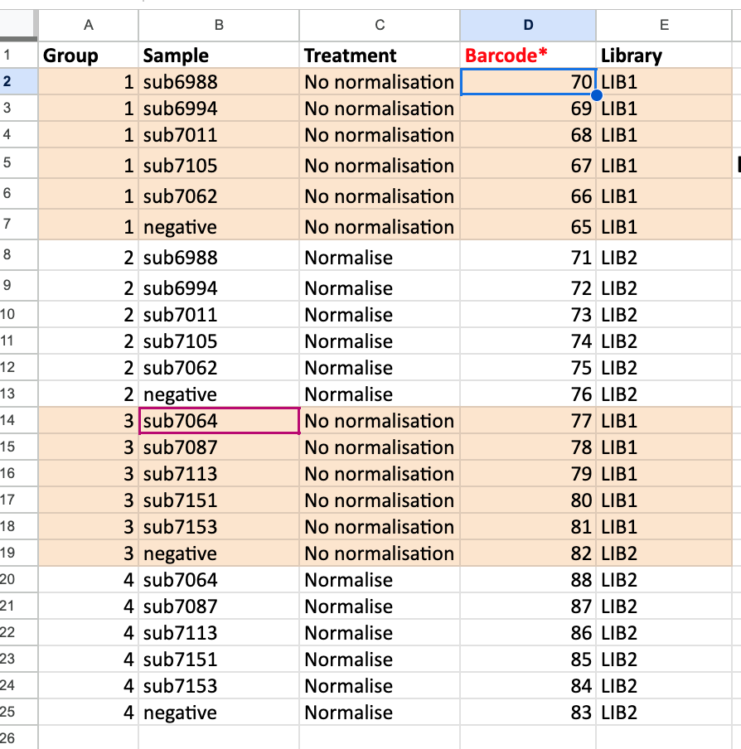

Validate metadata and perform regular quality control checks.

Slide 14
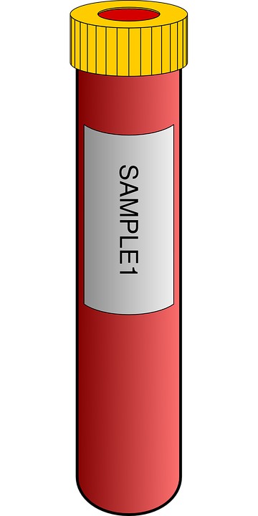
Include relevant information such as sample identifiers, characteristics, and experimental conditions.
Sample 1
Blood
Collected: Gartnavel hospital
Received: 12-Jun-2022

Slide 15


Establish linkages between metadata and associated data files
Common identifier
Sample 1
Patient A

Slide 16
Utilize standardized terminology and controlled vocabularies.
Data dictionary
Sample_id | Tissue_type | Host | Date
RV001 | Brain | Dog | 12/03/21
RV123 | Saliva | Canid | 01.05.2020
RV432 | Brain | Canis familiaris | October 19

Slide 17

Capture metadata provenance and maintain a record of data entry and updates.
Source, authorship and modification history

Slide 18

Backup metadata and use version control.
Can recover data if needed
Trace edits, whether accidental or not

Slide 19

Implement data security and privacy measures.
Data protection
Some data may be sensitive
Set view, edit and admin privileges

Slide 20
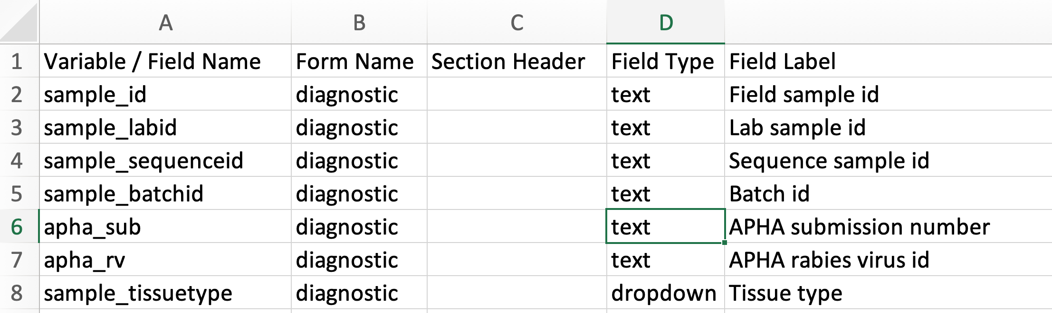
Data formats
Common source of problems
Given a choice users will use abbreviations/colloquialisms
Standardisation is so important
Provide a template and a definition of fields (data dictionary)

Slide 21
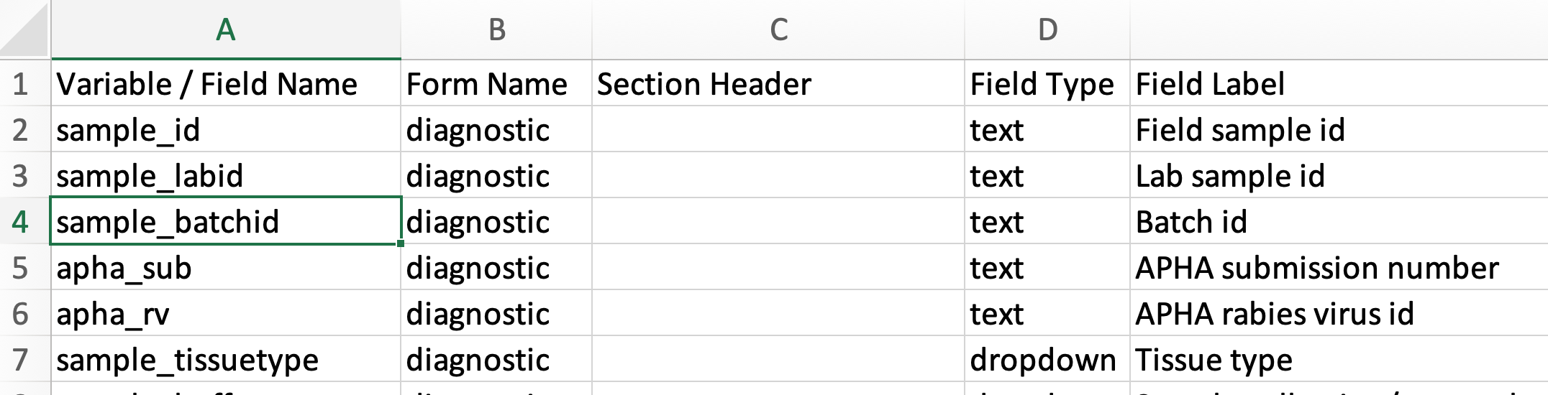
Example: data dictionary

Slide 22
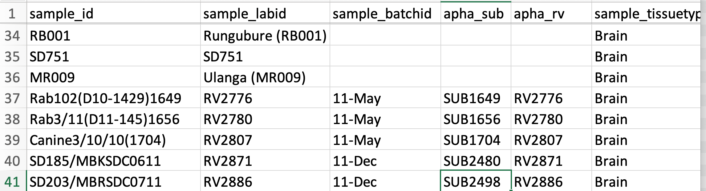
Example: sample metadata

Slide 23
Minimal metadata
Consider your research questions and the type of analysis you want to do
What data do you need?
Make sure that data is collected!

Slide 24
Minimal metadata: phylodynamics
Phylodynamics = analysis that integrates spatio-temporal-genetic data
Require:
Sequences
Date associated with case e.g. symptoms started, sample collected
Case location e.g. GPS coordinates, village, district
The more resolved this data is the more informative your analysis will be

Slide 25
Summary
Metadata is extremely important
Collect the right information for your desired analysis/outputs
Make your life easier by having good practices in place from the offset

